Slide 1
CS3x00 Technical Training Basics
November 2022

Slide 2
AGENDA
1
CS 3x00 Overview
7
Maintenance
2
Workflow
8
Troubleshooting
3
CS 3600 / CS 3700
Technical Description
9
Escalation
4
CS 3800 Technical Description
10
Tips
5
Software Version and Installation
11
Spare Parts
6
Licensing

Slide 3
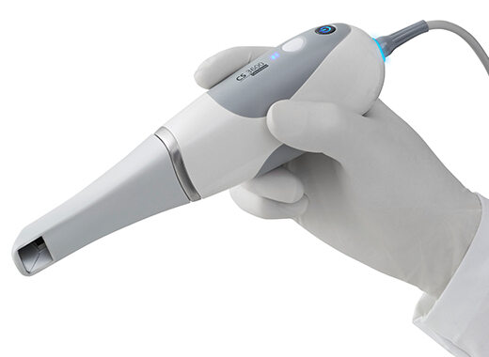
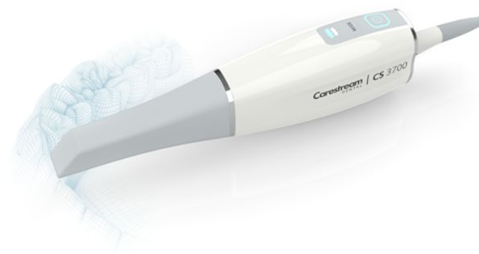
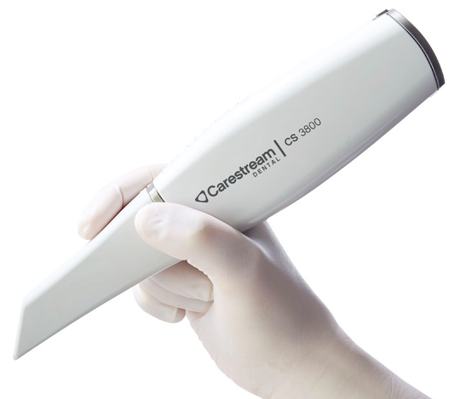
CS 3x00 Overview

Slide 4
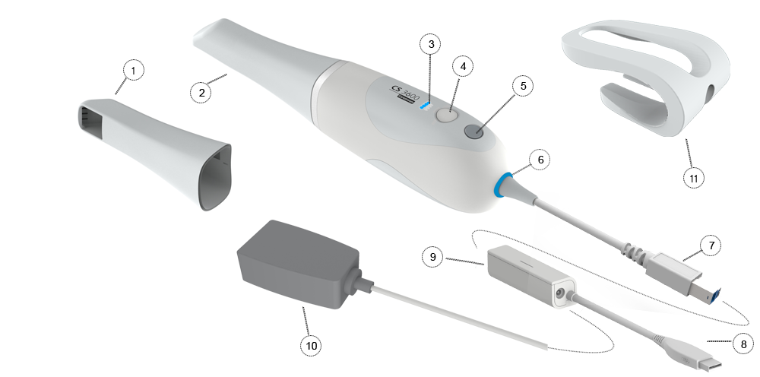
CS 3600 Family System Components
1. Side Tip
2. Normal Tip
3. Mode Indicators
Lower jaw scan mode
Upper jaw scan mode
Buccal bite registration mode
4. Mode Button
5. Power Button
6. USB Connection Indicator
Blue indicates the connection is established.
No light indicates the connection is disconnected.
7. Scanner Connector
8. USB Connector
9. Power Box / Cable
10. Power Adaptor
11. Holder

Slide 5
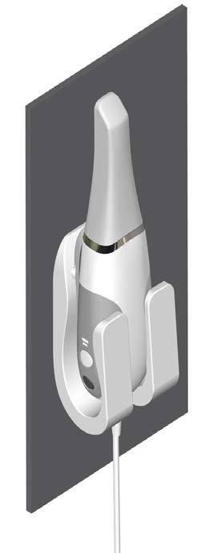
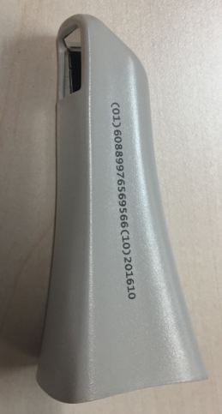
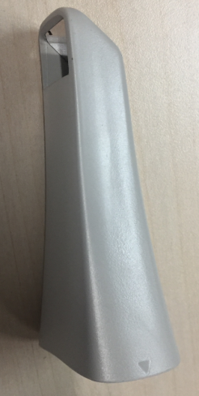
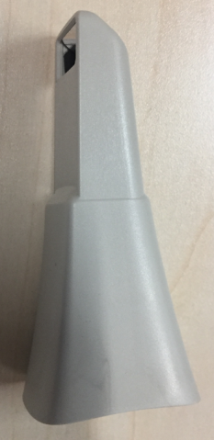
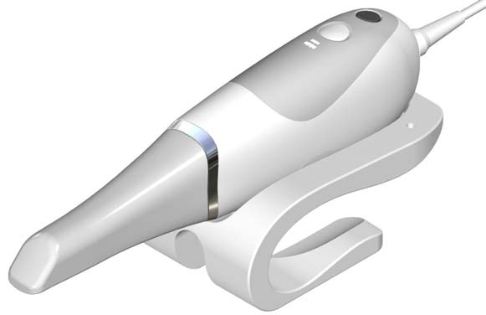
CS 3600 Family System Components
2 Versions:
Standard and Access
Wall Stand Holder
Normal tip
FOV: 13mm x 13mm
Side tip
FOV: 13mm x 13mm
Posterior tip
FOV: 13mm x 7mm
 | Exposure Time at 132 ℃ | Exposure Time at 134 ℃ | Minimum Drying Time
Pre-Vacuum Autoclave | Minimum 4 Minutes | Minimum 3 Minutes | 20-30 Minutes
Gravity Autoclave | Minimum 15 Minutes | Minimum 10 Minutes | 15-30Minutes
Desktop Holder

Slide 6
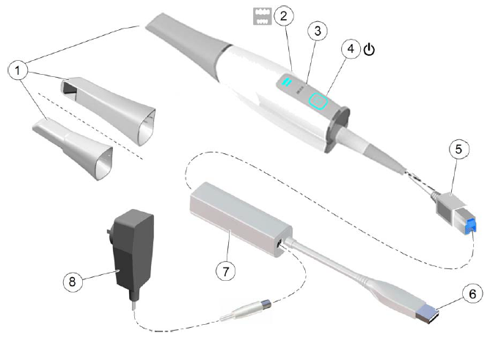
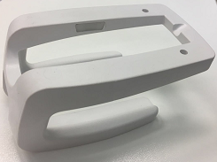
CS 3700 Family System Components
1. Reusable tips
Normal tip
Side tip
Posterior tip
2. Mode indicators
Lower jaw scan mode
Upper jaw scan mode
Buccal bite registration mode
3. Mode button
4. Power button
Constant blue: Scanner is active
Slowly blinking: Scanner not connected.
Rapid Blinking: Hardware error
5. Scanner Connector
6. USB Cable
7. Power Box / Cable
8. Power Adaptor
9. Holder
10. Shade Calibration Unit
⑩
⑨
6

Slide 7
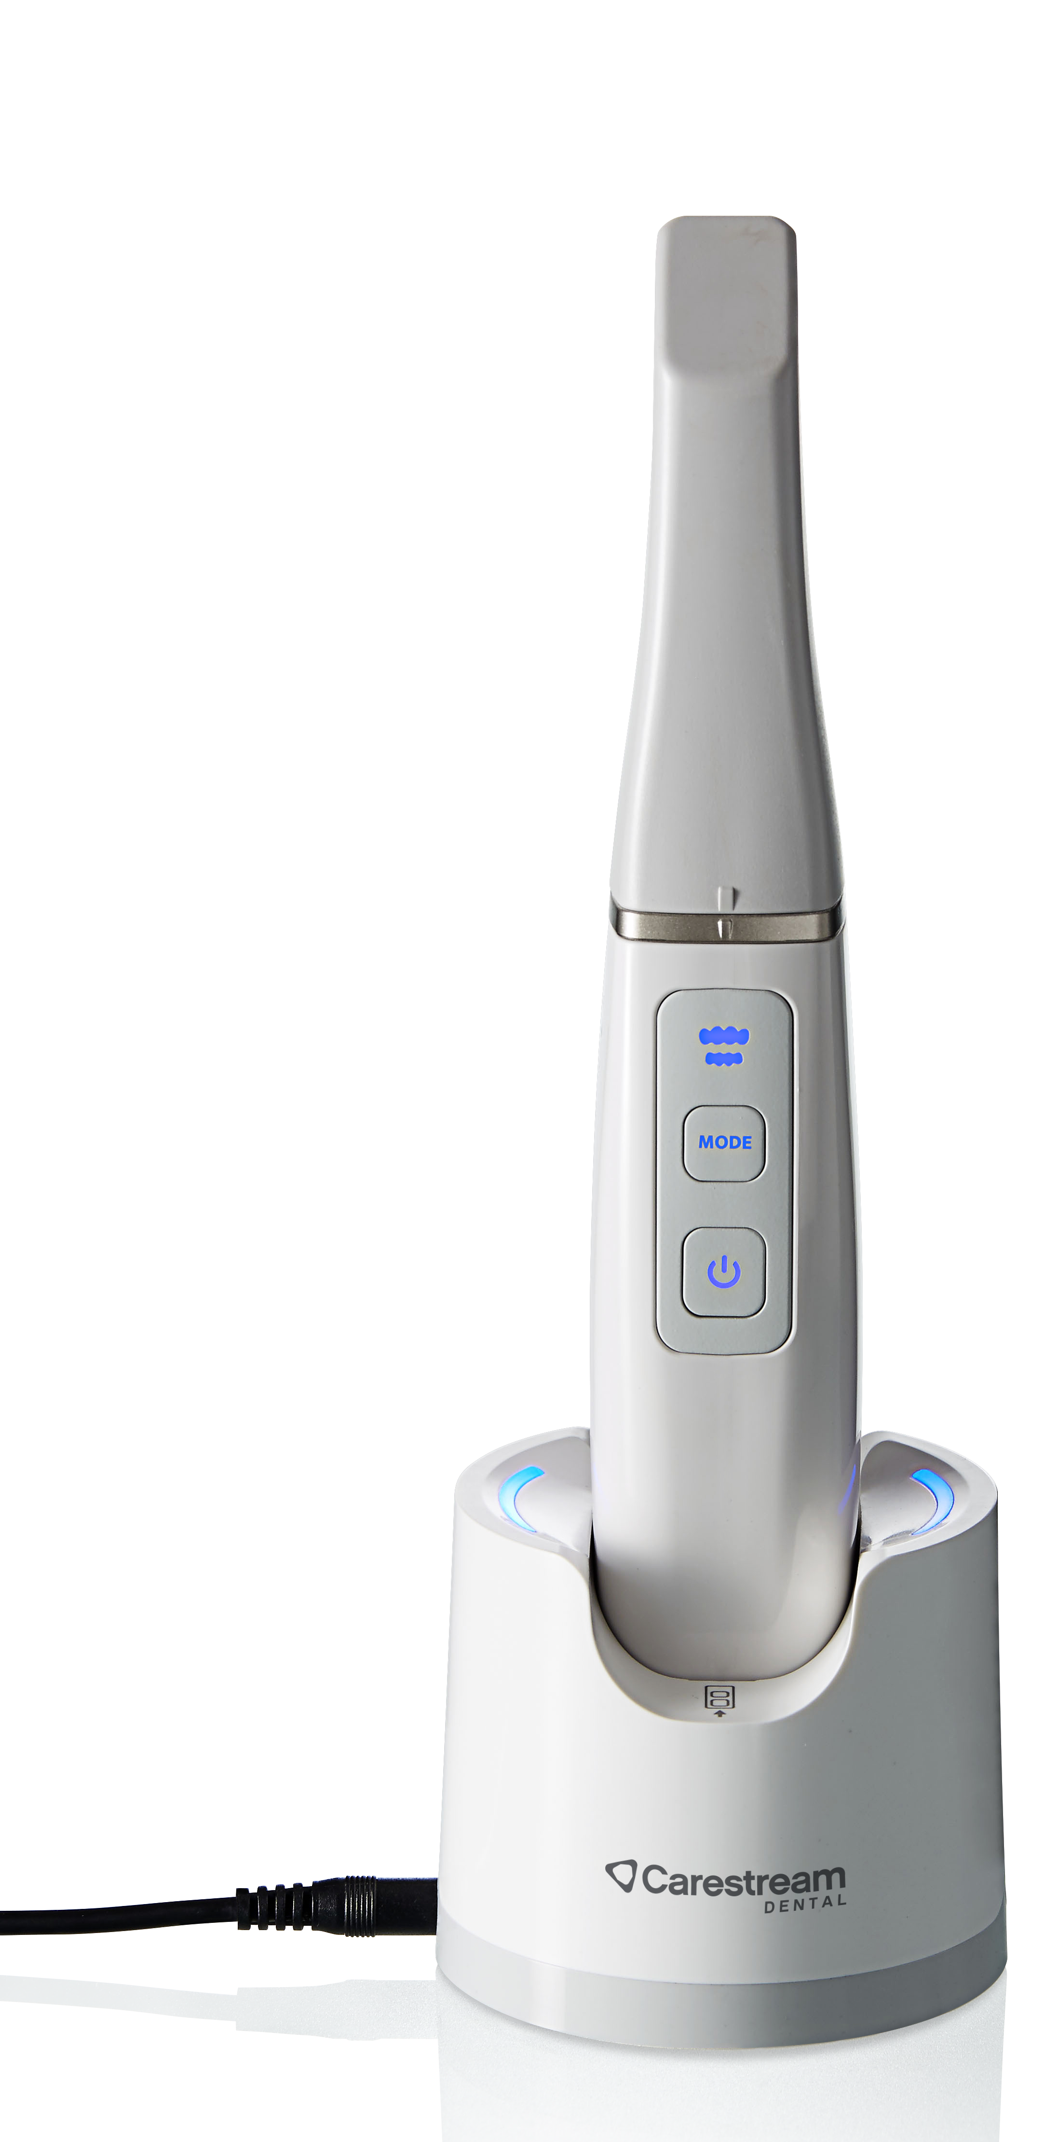
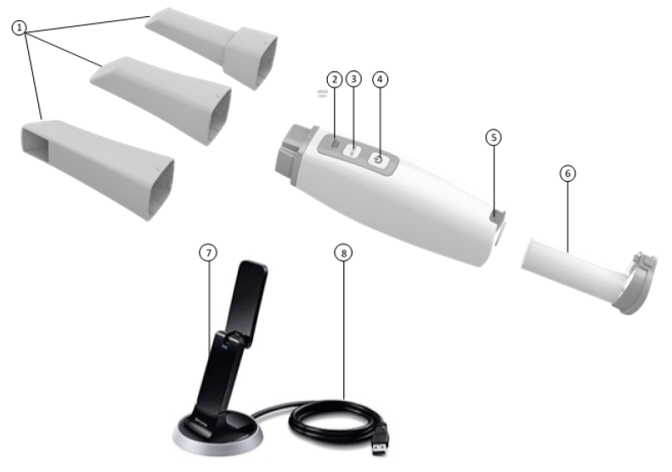
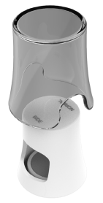
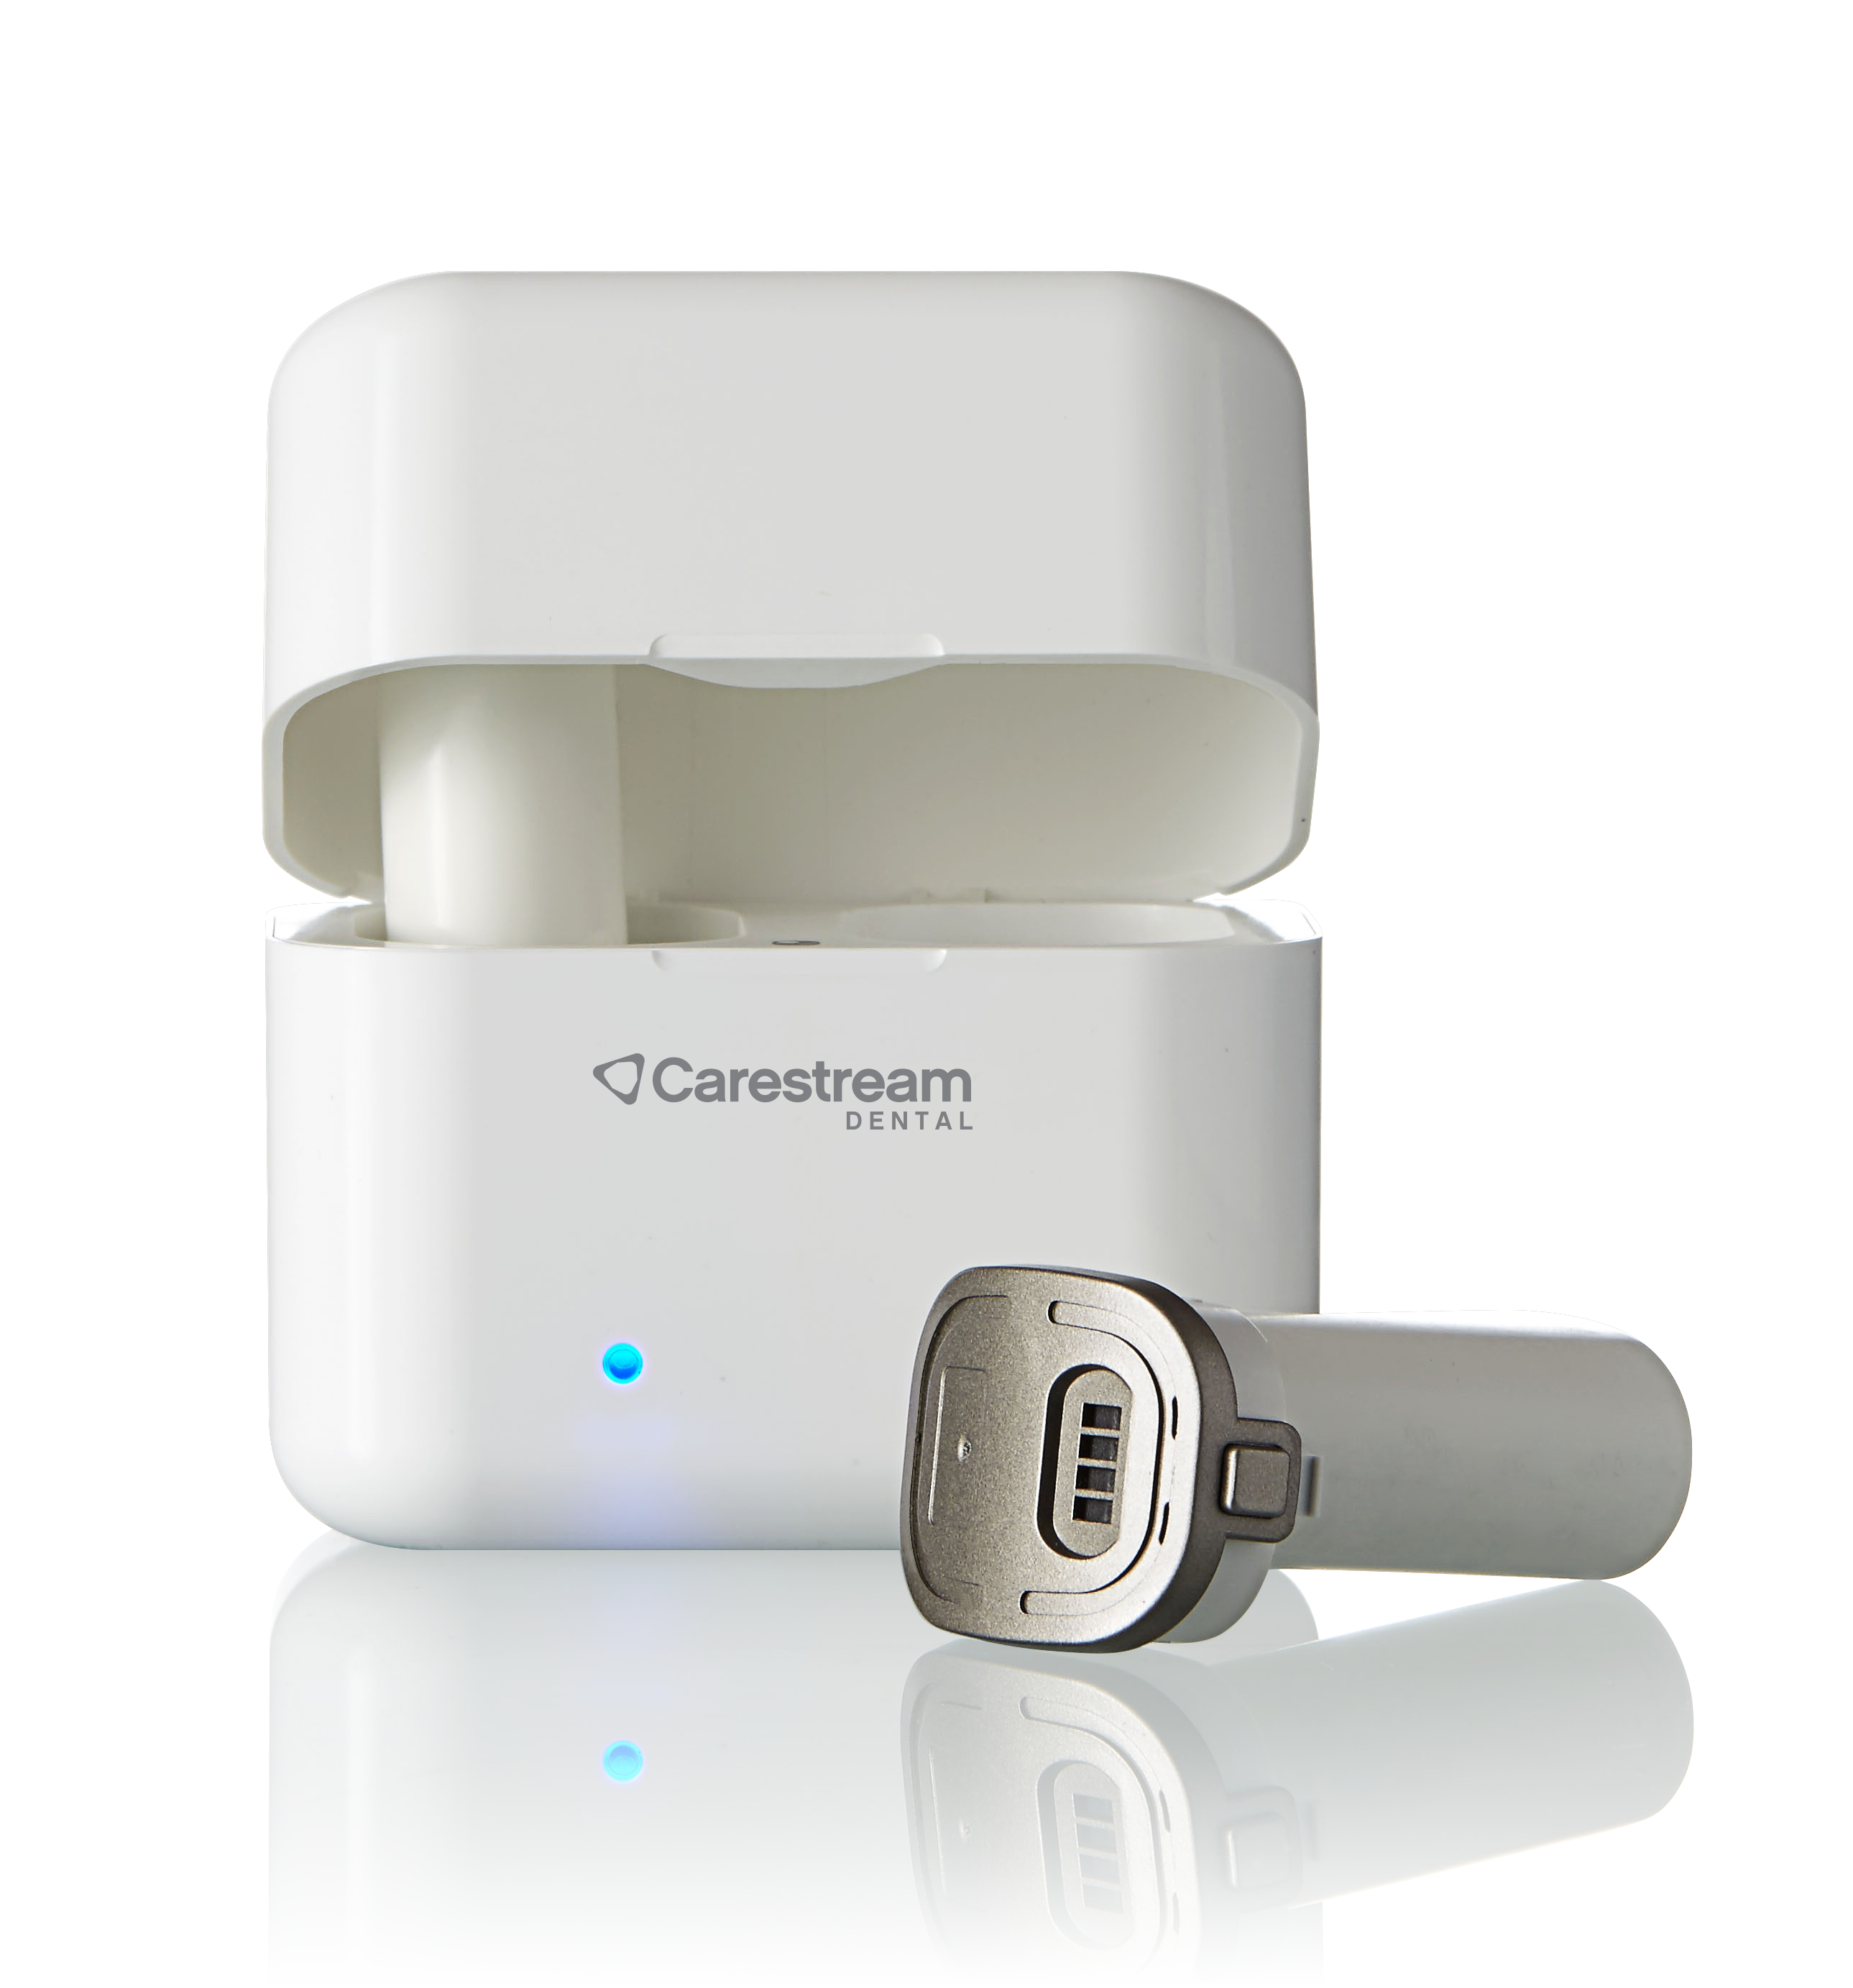
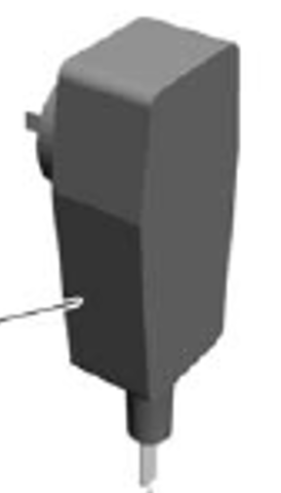
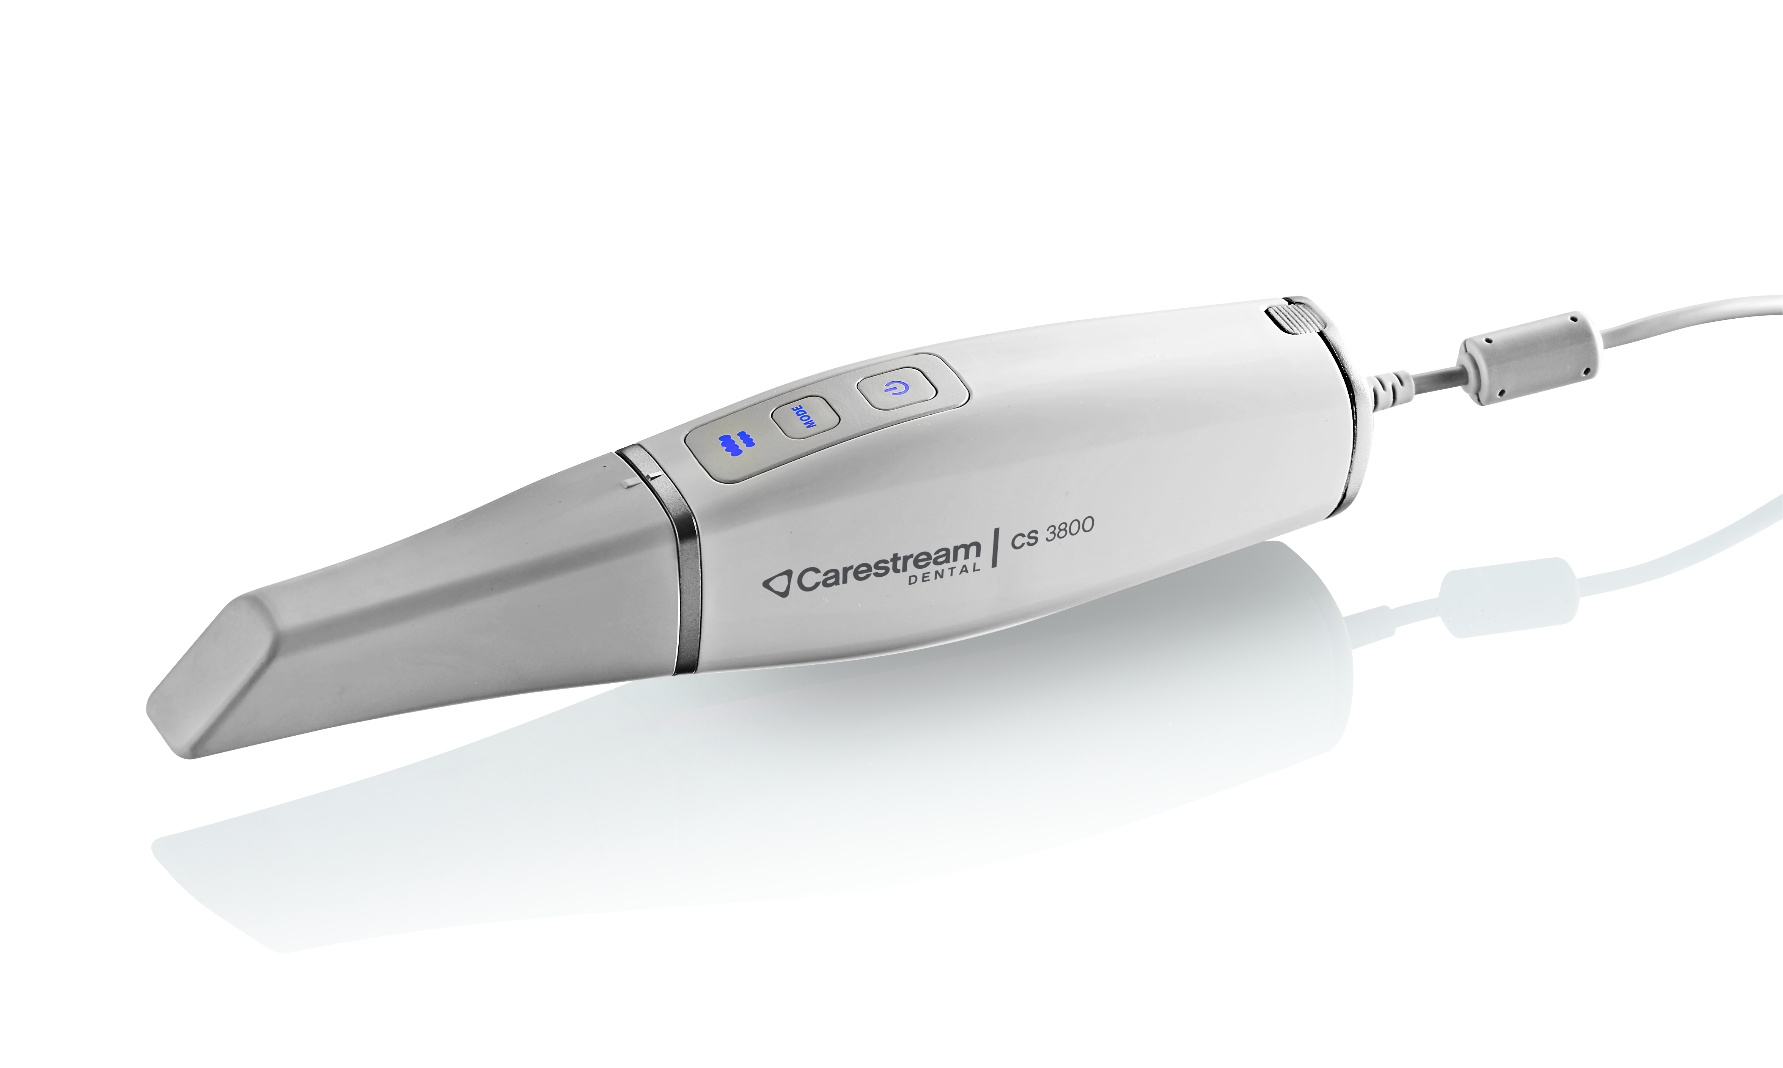
CS 3800 Family System Components
Reusable tip
Mode indicator
Mode button
Power button
Power connector
Battery
Wi-Fi adapter
Dock for Wifi adapter
Shade calibration unit
Power Adapter
Charger Station
10
9
Battery Charger Case with 2 extra batteries (Option)
Power cable

Slide 8
CS 3800 Technical Specifications
Components | CS 3800 Wireless | CS 3700 | CS 3600
Sensor technology | 1/2.9 inch CMOS | ½ inch CMOS | ½ inch CMOS
Illumination | LED: Amber, Blue, Green | LED: Amber, Blue, Green | LED: Amber, Blue, Green
Field of view | 16 x 14 mm 13 x 7 mm (posterior tip) | 13 x 13 mm 13 x 7 mm (posterior tip) | 13 x 13 mm 13 x 7 mm (posterior tip)
Depth of field | -2 to +16 mm | -2 to +12 mm | -2 to +12 mm
Anti-fogging technology | By airflow, guaranteed non-fogging operation when used intraorally | Actively heated tip; guaranteed non-fogging operation when used intraorally | Actively heated tip; guaranteed non-fogging operation when used intraorally
Digital connection | Wi-Fi 5GHz, 802.11ac | USB 2.0 High Speed | USB 2.0 High Speed
Dimensions without cable | 226 x 38 x 60 mm for normal and side tips | 220 x 38 x 58 mm for normal and side tips | 220 x 38 x 58 mm for normal and side tips
Weight | 240 g (with battery) | 325 g (excluding scanner cable and power box) | 325 g (excluding scanner cable and power box)
Handpiece | Input: 12V 2.5A (with power cable) 3.6V 3A (with battery) | Input: 12V 2A | Input: 12V 2A

Slide 9
Workflow

Slide 10
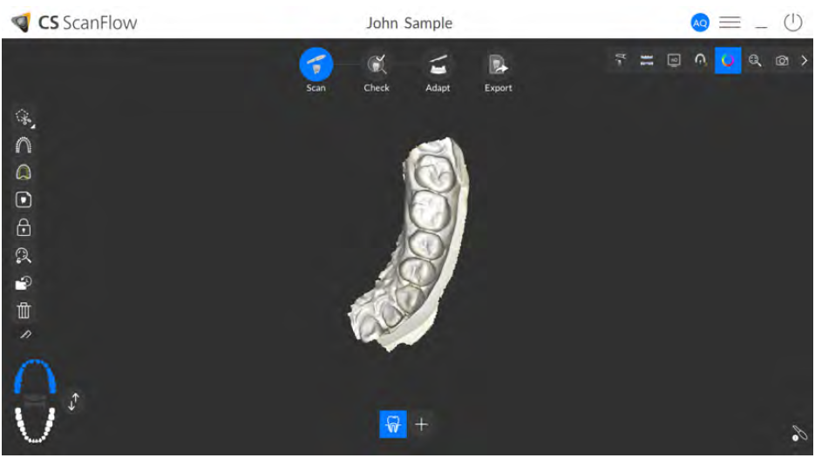
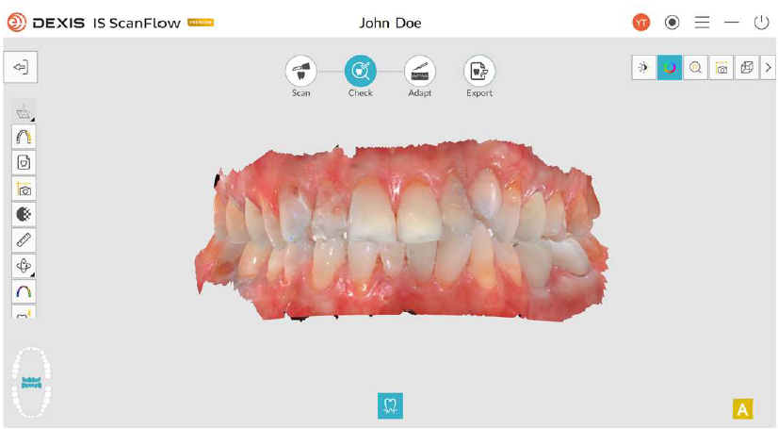
Workflow
CS ScanFlow IS ScanFlow

Slide 11

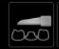
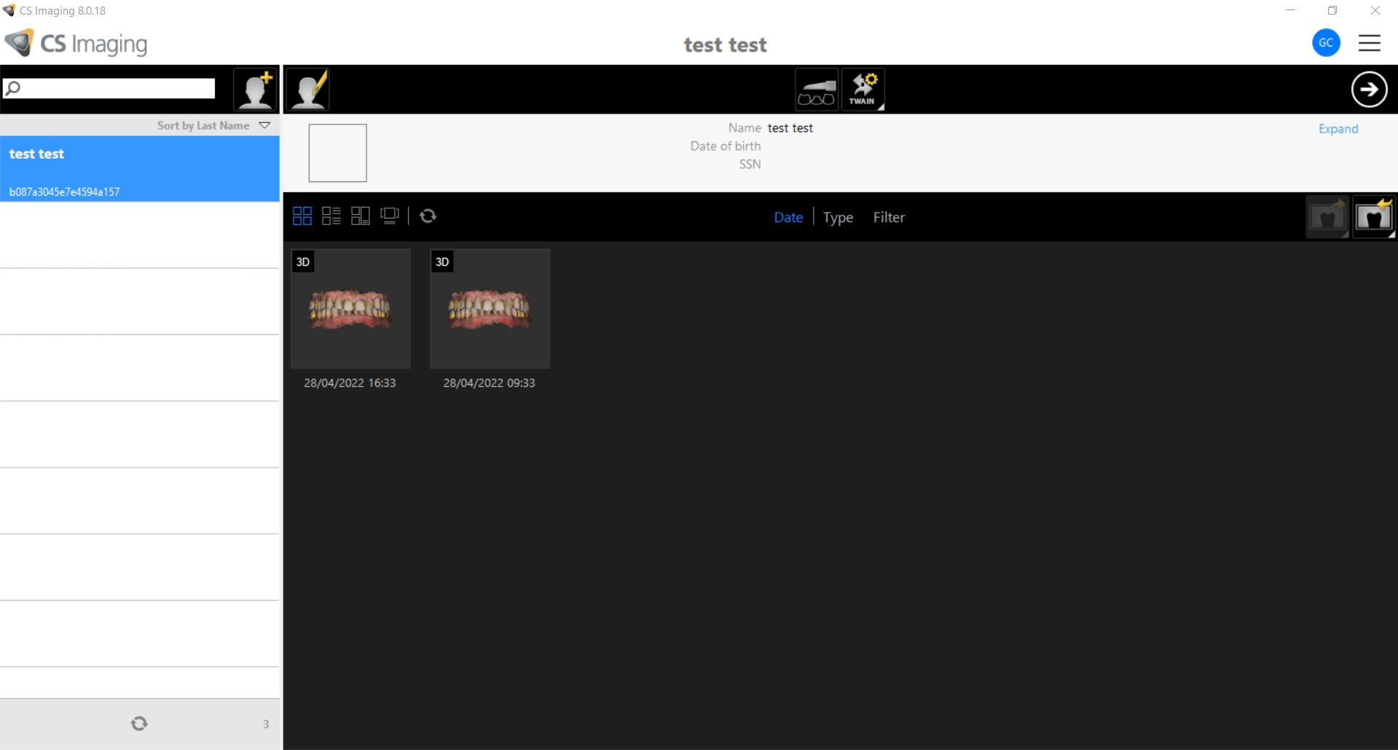
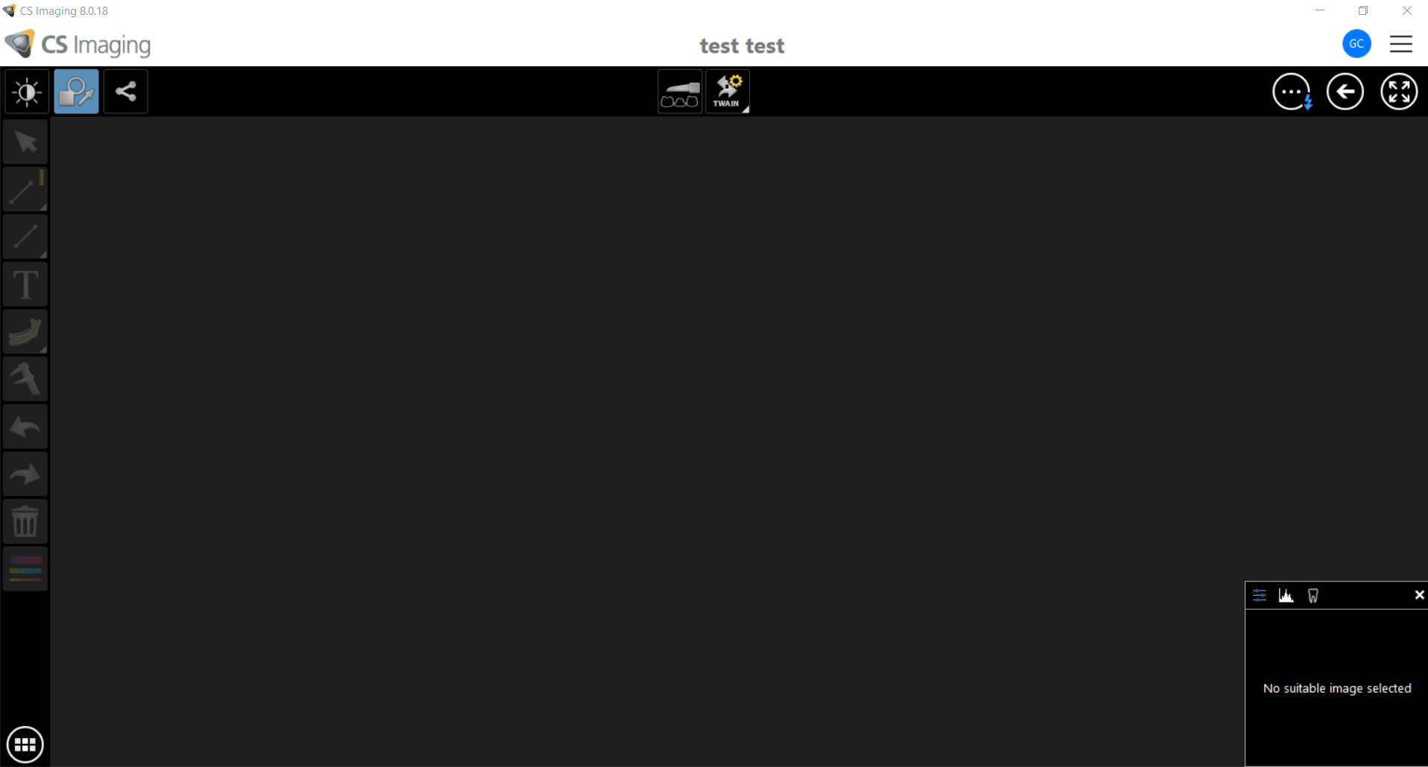
Workflow with CS Imaging 8
Open CS Imaging 8
Select or Create a patient
Click on the IOS Acquisition Button to open CS ScanFlow
In case of Stand-Alone
In case of DPMS

Slide 12
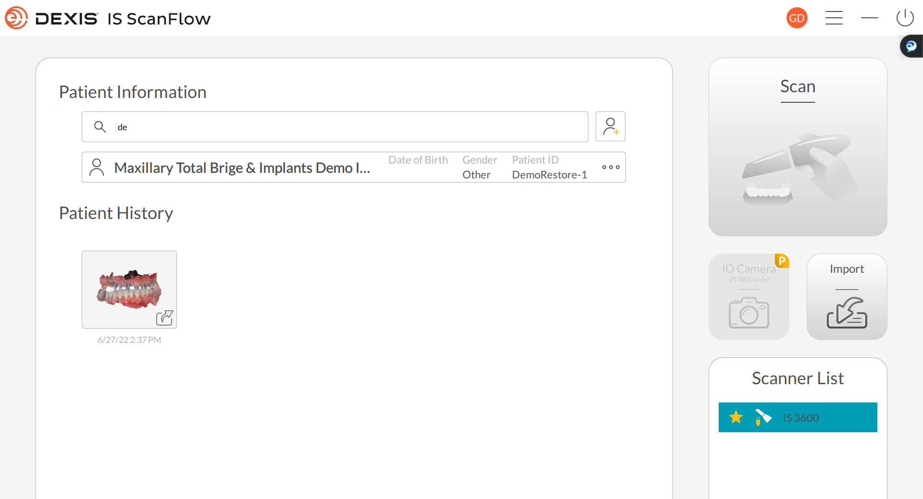
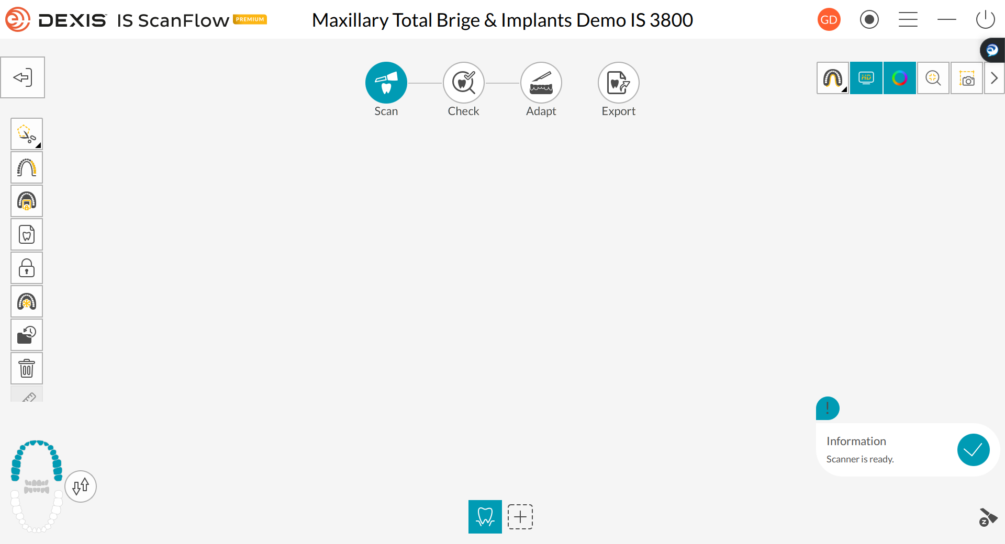
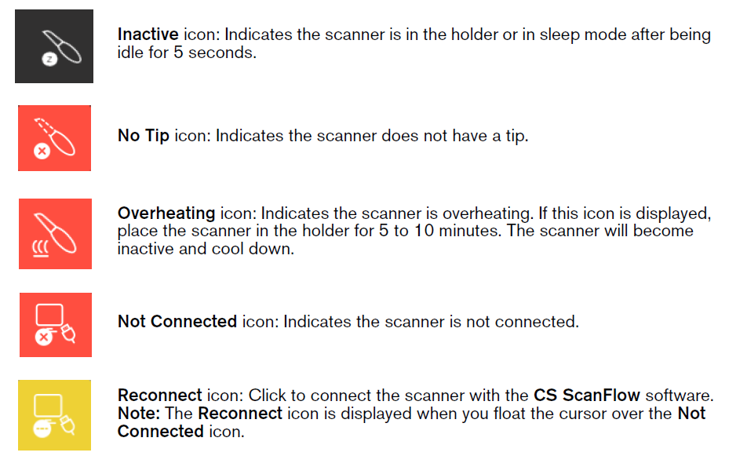
Workflow with IS ScanFlow 1.0.7

Slide 13
CS 3600 / CS 3700
Technical Description

Slide 14
Computer System Requirements
 | Recommended
CPU | Laptop: Intel Core i7-7700HQ, Quad CPU, 2.8 GHz
 | Desktop: Intel Core i7-7700K, Quad CPU, 4.2 GHz
RAM | 16 GB RAM
Monitor | Standard CRT/LCD monitor with screen resolution of 1920 X 1080
Operating system | Windows 10/11 Professional (64bit)
USB | USB 2.0 high speed port is required
Video card | Laptop: NVIDIA GeForce GTX 1050 Ti / Quadro P3000 or similar
 | Desktop: NVIDIA GeForce GTX 1050 Ti or similar
Video card driver | Support OpenGL 4.3 and OpenCL 1.1

Slide 15
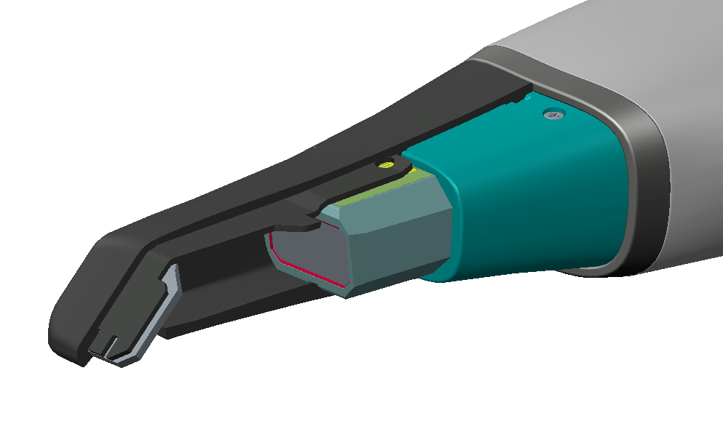
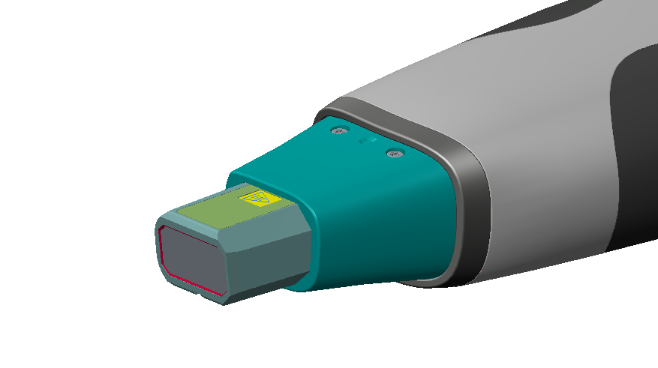
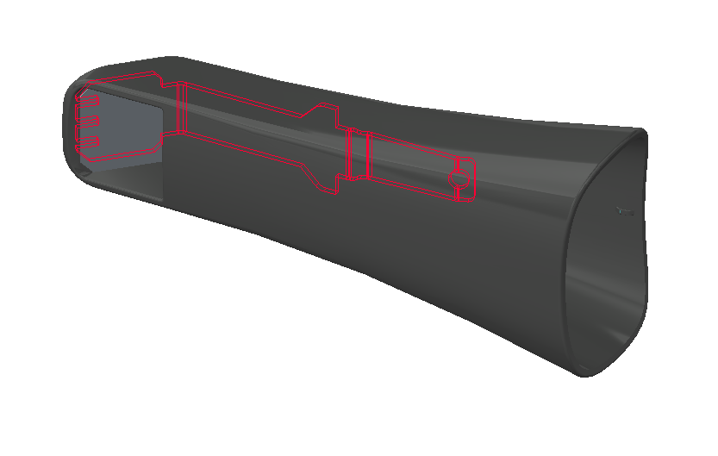
Anti-fogging for CS 3600 and CS 3700
Aluminum Plate
Heater
Protective Window
Tip Mount
To enable the anti-fog feature, place the tip on the scanner and allow the scanner to warm up for 3 minutes before starting the acquisition.

Slide 16
CS 3800 Technical Description

Slide 17
Computer System Requirements
 | Recommended
CPU | Laptop: Intel Core i7, 9th generation
 | Desktop: Intel Core i7, 9th generation
RAM | 16 GB RAM
Monitor | Standard CRT/LCD monitor with screen resolution of 1920 X 1080
Operating system | Windows 10/11 Professional, version 1809 or higher
USB / DVD-ROM | USB 3.0 for WiFi adapter
Video card | Laptop: NVIDIA GeForce RTX 2060, 6 GB memory
 | Desktop: NVIDIA GeForce GTX 1660Ti, 6 GB memory
Video card driver | Support OpenGL 4.3 and OpenCL 1.1

Slide 18
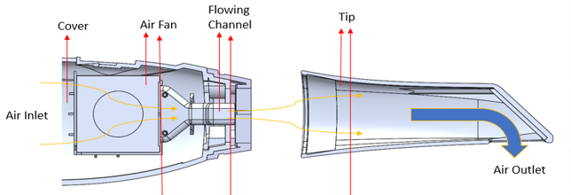
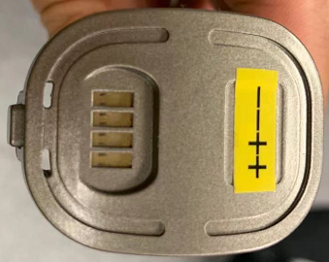
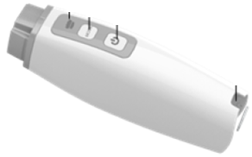
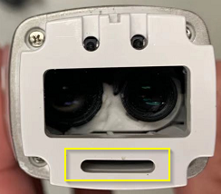

Air Flow/ Anti Fog
Air Inlet
Do not Block!
Air Outlet

Slide 19
Scanner Positioning
1. Put the scanner into the handpiece charging station vertically. (With battery only)
2. Put the scanner on the station horizontally.
Note the direction, the tip should face up

Slide 20
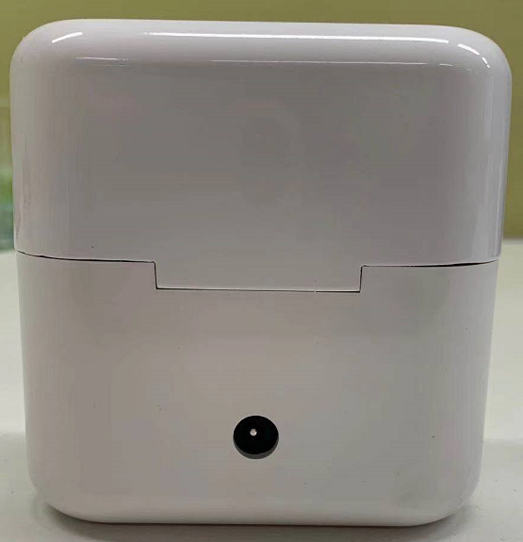

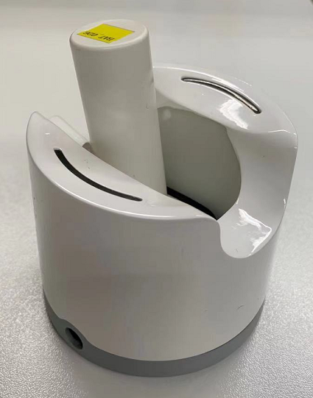
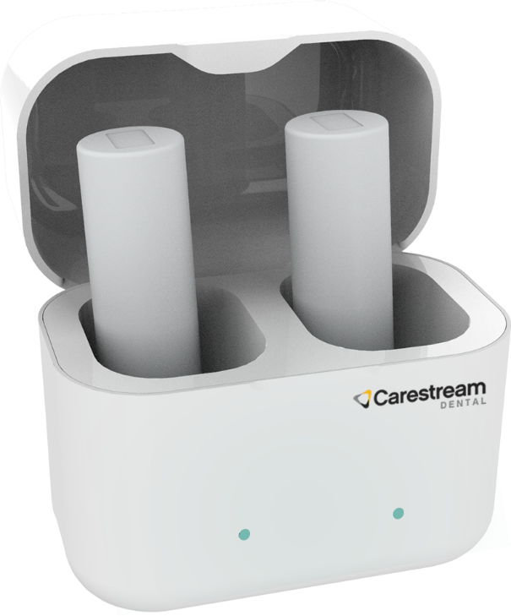

Charging the Battery
Use the battery charging station to charge the battery.
The battery charger use the same power adapter as the scanner.
DO NOT charge the battery without the handpiece with the HP charging station.

Slide 21
Optional Accessories
Battery Charging Station.
Blinks in ORANGE when the battery is near empty.
Blinks in BLUE when the battery is half full.
Displays a CONSTANT BLUE when the battery is fully charged.
Input: 12V 2.5A
Output: 4.2V 3A
Note: When charging a single battery, the output is 3A. When charging two batteries at the same time, the output of each slot is limited to 2.4A, to prevent the power adapter from being
overloaded. It takes 110 minutes to fully charge a single battery and 130 minutes for two.

Slide 22
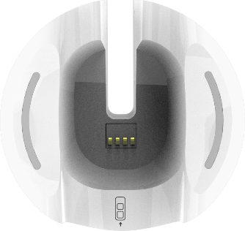
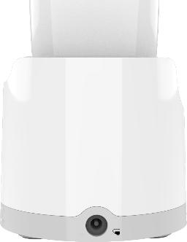
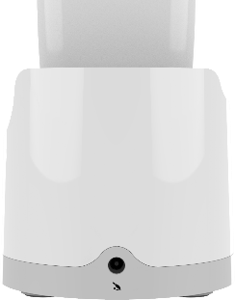



Handpiece charging station
Input: 12 V 2.5A
Output 1 (charging port): 4.2 V 3A (4 pins)
Output 2 (port for power cable): 12 V 2.5A/ 3.5 mm DC plug
Charging Indication LED
Input
Output 2
Output 1
Note: When the power cable is attached to Output 2, Output 1 is muted and will not charge the handpiece.

Slide 23
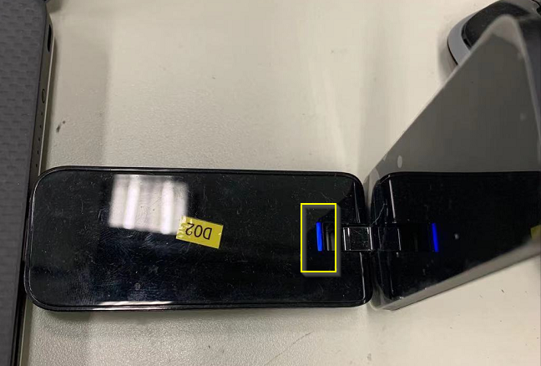
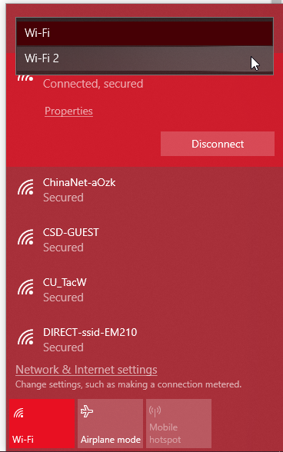
Connection of the scanner
No need to config the Wi-Fi connection!
The LED on the Wi-Fi adapter will blink if there is no scanner connected.
Once the scanner is connected to the adapter, the LED will turn to constant blue.
If the LED doesn’t light up, try another port.
Must be a USB 3.0 port.
Replace the adapter if it’s defective.
An additional Wi-Fi panel will be displayed.
!!!DO NOT use it to connect any network, otherwise the CS 3800 can not be connected.

Slide 24
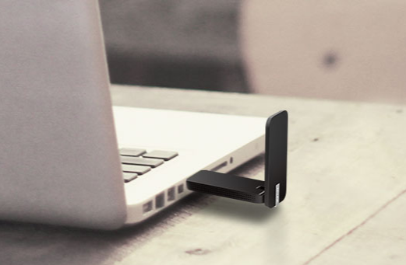
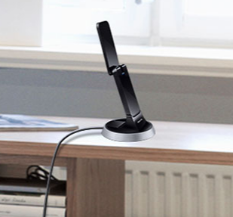
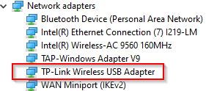
Setting up the Wi-Fi adapter
Plug Wi-Fi adapter to the PC (Use Windows Default Driver), either directly or through the dock.
Note: Must be USB 3.0 port.
In device manager the adapter will be recognized as TP-Link Wireless USB adapter.
Or
Note 1: The scanner itself is a 5GHz Wi-Fi access point (802.11ac) for the PC
Note 2: Check TN522
Notes:
Setting up the Wi-Fi adaptor
Plug the Wi-Fi adapter into the USB 3.0 port on the PC. You can use the extension dock, or just connect the adapter directly to the USB port.
The driver for the adapter will be installed automatically on the PC. It will be recognized as TP-Link Wireless USB Adapter in device manager -> Network adapters.
Note: The scanner itself is a 5GHz Wi-Fi access point (802.11ac) for the PC
There is no need of Wi-Fi router and there is no impact to the practice's Wi-Fi network
The Wi-Fi adapter does not need to be paired with the IOS S/N

Slide 25
Software Version
and Installation

Slide 26
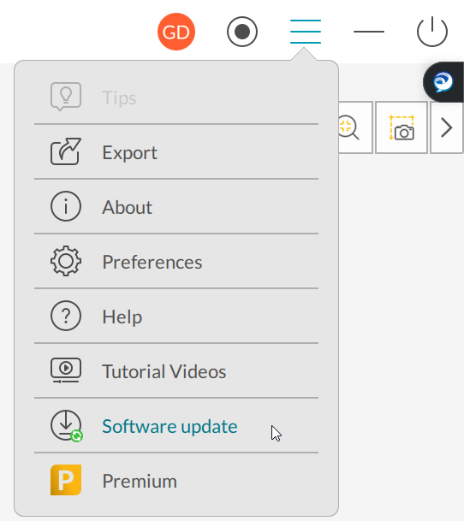
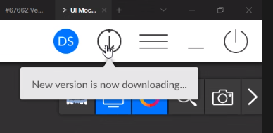
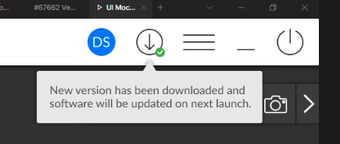
Software Version
Most of the install base should be using CS ScanFlow version 1.0.5 or 1.0.6.
A very small number of users are still using the old CS ScanFlow version 1.0.3
Starting from Version 1.0.5 the software can receive automatic updates using MSIX package
When the software starts, it checks the current version with http://sums.csdental.com/, in case is lower compared to the online version then will be downloaded.
The new release will be automatically pushed to the software and users all around the world will gradually get the update notification. The user can accept or postpone the software update, but the update will eventually be installed after one month.

Slide 27

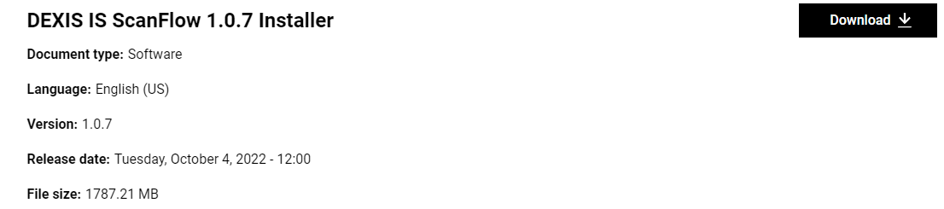
Software Version
Version 1.0.7 is currently available on tech.dexis.com and dexis.com

Slide 28
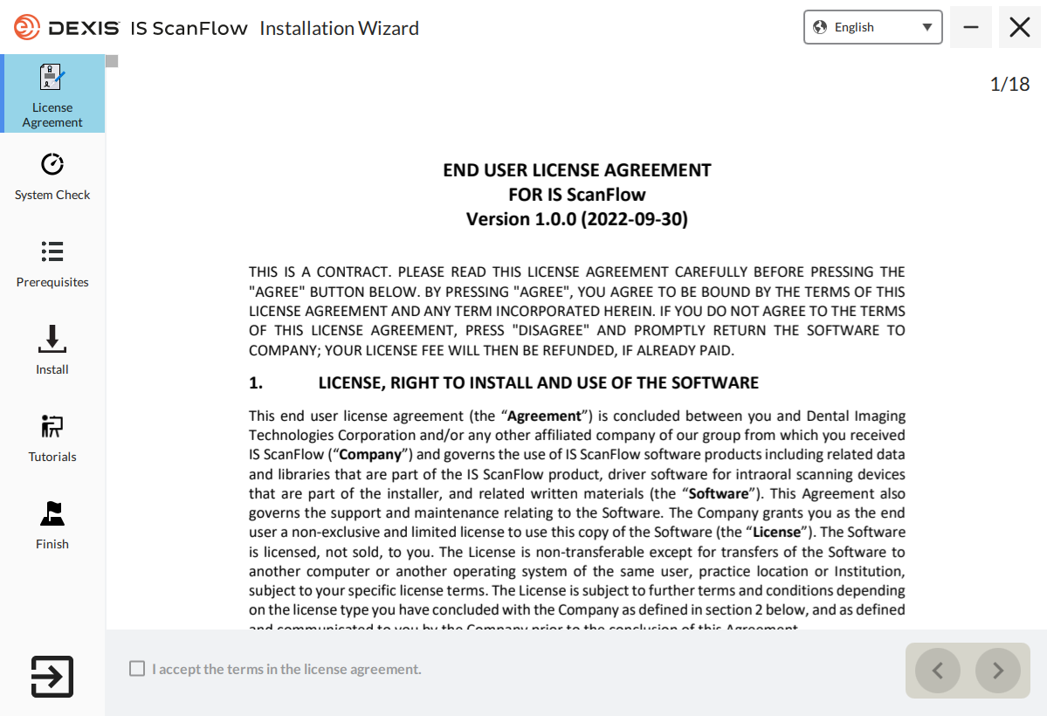
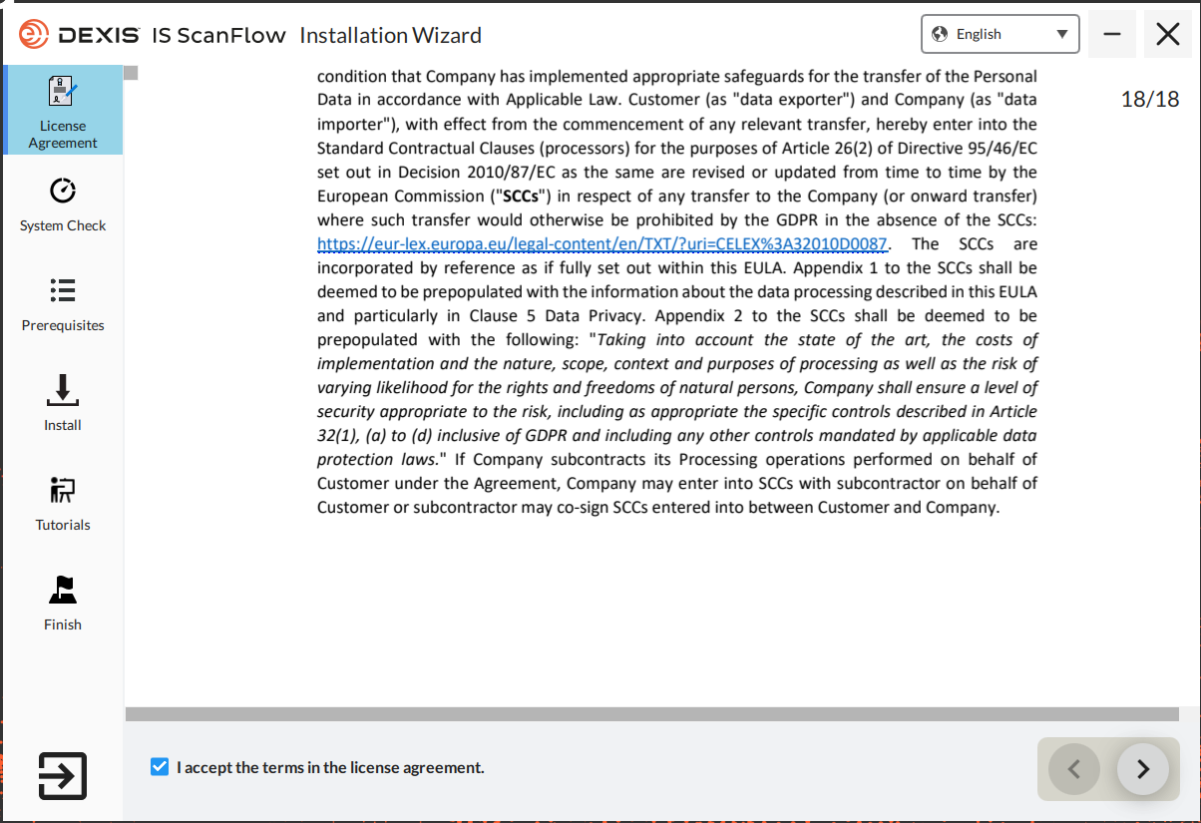
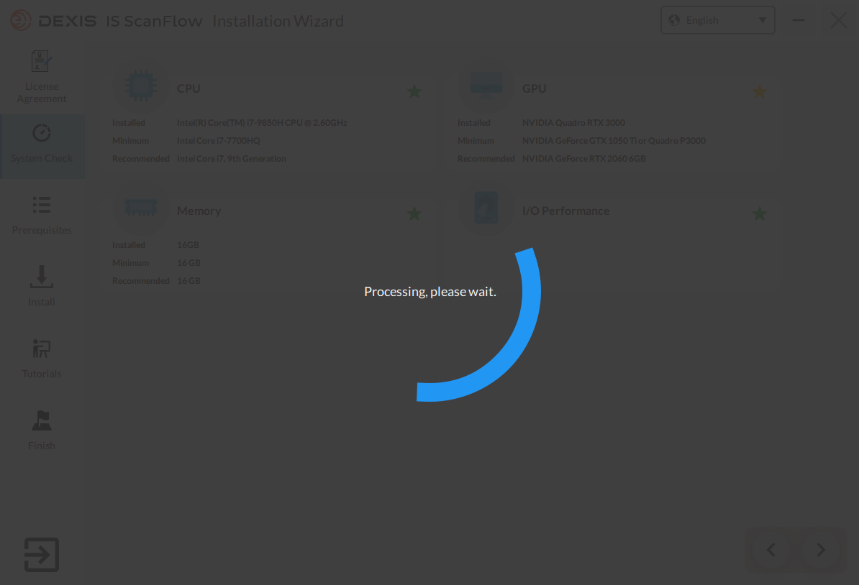



Software Installation
Start by mounting the ISO file InstallationWizard_1.0.7.9.iso and execute Autorun.exe as Admin
1.Scroll down
2.Check

Slide 29

Installation Type Selection
Integrated: For DTX or other imaging software
Standalone: No imaging software is required

Slide 30

Send to IS Connect Anytime
Only available for “Integrated”
Display scans acquired in integrated mode within 60 days

Slide 31


3x00 Basic Integration in DTX Studio™ Clinic
ScanFlow standalone Quick launch button will be made available from DTX Studio Clinic
Manual import of scan into DTX Studio Clinic and use the DTX Studio ecosystem (DTX Studio Go, DTX Studio Implant, DTX Studio Lab, DTX Studio Core ..) or one click away case transfer to QuickConnect partners / DEXIS

Slide 32

3x00 Basic Integration in DTX Studio™ Clinic

Slide 33
Licensing

Slide 34




Licensing
Activation is done via CS Activation Software, this software is installed with CS Imaging
A valid account needs to be created in the following website
https://csactivation.carestreamdental.com/
1

Slide 35
Licensing
Activation is done via CS Activation Software, this software is installed with CS Imaging
A valid account needs to be created in the following website
https://csactivation.carestreamdental.com/
From Version IS ScanFlow 1.0.7 is not longer required
1

Slide 36
Maintenance

Slide 37

Maintenance – for all IOS
Scanner Care – Disinfecting the scanner
After each patient, the scanner must be thoroughly disinfected.
To disinfect the scanner, follow these steps:
Remove the reusable tip.
Remove all visible soil (see “Cleaning the Scanner” ).
Use a commercially prepared intermediate level disinfectant wipe. Follow the manufacturer’s instructions for contact time.
Thoroughly wipe all surfaces of the scanner. DO NOT allow liquid to enter through the gap, air outlet, or pin holes.
Allow to air dry.
After the scanner has dried, use a clean, lint-free cloth dampened with water to remove residual disinfectant from the surface of the scanner.
Approved disinfectant wipes: Mikrozid AF Jumbo Wipes, CaviWipes, Oxivir Tb Wipes, Clorox Healthcare Bleach Germicidal Wipes, PDI Sani-Cloth Bleach Germicidal Wipes.
WARNING: Using a disinfectant that has not
been approved may cause damage to the scanner.

Slide 38
Maintenance – for all IOS
Cleaning the Scanner Tips
NOTE: Scanner tips received from the manufacturer are NOT sterile. You must sterilize the tips before the first use.
To sterilize the cleaned scanner tips, follow these steps:
Place the tip in an FDA-cleared or CE-marked sealed sterilization pouch. The pouch should be sealed air-tight. Use either a self-adhesive pouch or a heat-sealed pouch.
Place the tips in a steam autoclave for the following times:
Important: Do NOT exceed 134°C
 | Exposure Time at 132 ℃ | Exposure Time at 134 ℃ | Minimum Drying Time
Pre-Vacuum Autoclave | Minimum 4 Minutes | Minimum 3 Minutes | 20-30 Minutes
Gravity Autoclave | Minimum 15 Minutes | Minimum 10 Minutes | 15-30Minutes
Note: Autoclave tip 110 cycles maximum for IS 3800 / 60 cycles for IS 3600 and IS 3700
More information in Safety&Regulary Guides

Slide 39





Maintenance – CS 3800
Use the protective cover when the scanner is not in use.
Use the bottom cover when the battery is removed.
Scanner Care
Clean the scanner
If the scanner is visibly contaminated with blood and/or body fluids, you must clean it before disinfecting it.
WARNING: DO NOT touch the contact points on
the battery or the scanner. DO NOT allow liquid to infiltrate the cover.

Slide 40
Troubleshooting

Slide 41
Troubleshooting
The installation directory has been changed to
→ C:\Program Files\WindowsApps\D.I.T.C.DEXIS-IS-ScanFlow_1.0.7.9272_x64__9454mxajnpdsp
Please note the diagnose tool and log files remain the same directory
Diagnostic Tool → C:\ProgramData\DEXIS IS\ScanFlow\DiagnoseTool\bin\is3x00_diagnose_tool.exe
Log files → C:\ProgramData\DEXIS IS\ScanFlow\log
Maintenance Tool → C:\ProgramData\DEXIS IS\ScanFlow\maintenance_toolkit\
scanflow_maintenance_tool_backend.exe

Slide 42


Troubleshooting
If for any reason the installation fails, you can no longer uninstall the software via “Uninstall or change a program” as with previous versions.
To reinstall or uninstall the software, please follow below steps.
1. From the start menu, select IS ScanFlow Maintenance Tool and open it.
2. With the CS Maintenance Toolkit, you can Modify, Repair or Uninstall the software.
Repair will execute all installation and all software component will be reinstalled.
Uninstall allows you to uninstall the software.

Slide 43


Troubleshooting
If the software installation still failed, you will need to reset the software. Follow below steps:
1. Right click CS ScanFlow Maintenance Tool and select > More > App setting
2.Click Reset
3. Reinstall the software

Slide 44


Device Identification
Scanner Recognition
In device manager CS 3600 & CS 3700 are detected as
libusbK USB device.
If the scanner is recognized as Media gadget device.
Manually install the driver under below path
C:\ProgramData\DEXIS IS\ScanFlow\post_install
UVCDriver_CS 3600
UVCDriver_CS 3700
Note: CS 3800 as it is using a USB dongle, will not be visible as a libusbK Device

Slide 45

Performance
Freezing or Scan slowness
Select the higher performance graphic process
Add a customer rule for the acquisition software
Select the higher performance graphic process for the acquisition software
Path: C:\Program Files\WindowsApps\D.I.T.C.DEXIS-IS-ScanFlow_1.0.7.9272_x64__9454mxajnpdsp \ DEXIS IS ScanFlow
Settings for Quadro graphic cards
On the Global Settings tab
Select either of these 2 presets
3D App - Game Development
Workstation Dynamic Streaming

Slide 46


Diagnose Tool
C:\ProgramData\DEXIS IS\ScanFlow\DiagnoseTool\bin\is3x00_diagnose_tool.exe

Slide 47



WIFI Signal Strength Check

Slide 48

Tip Diagnose

Slide 49





Tip Detection – Working Theory IS 3600 / 3700
Working Theory
The scanner has a tip calibration value: Value 1 and Value 2 which calibrated with no tip. The sensor in the scanner will check the capacity of the tips. Due to different position of the metal sheets on the tip. Different values of capacity will be detected.
Value 1 raises obviously: Normal Tip
Value 2 raises obviously: Side Tip
Value 1 and Value 2 raises obviously: Posterior Tip.
Normal Tip
Side Tip
Posterior Tip

Slide 50





Tip Detection – Working Theory CS3800
If the tip is not detected,
Check if the pin on the tip is broken
Push the switch and check if it is functional.
Make sure the marks are aligned when installing the tip to prevent any damage.

Slide 51

Accuracy Test
CS 3600 - SPCX635
CS 3700 - 5942743
CS 3800 - SPCX749

Slide 52

Debug Mode
Should be Nvidia Graphic card
Range：1~12 for CS 3800
Algo
Press Ctrl+Shift+D to open Debug
Acq
Scanner
Notes:
Press Ctrl+Shift+D to open Debug. The debug view is separated into 4 modules:
Algorithm tab show the status of the real capture FPS and consumption of the PC resourse.
The Capture FPS of the CS 3800 has been increased to 12. This value reflects the speed and smoothness of the scanning. Normally this value should be more than 8.
Scanner tab shows the Serial Number, battery status, Signal quality, Data transmission speed and the temperature status.
Acq tab shows the acquisition status including capture counts, capture average time, etc. The important value to check is the matching success Rates which reflects the accuracy of the scanner. The matching success rate is normally higher than 80%.

Slide 53

Error Code
If the scanner has hardware issue, a warning of hardware error will popup. Below is the table of the error details.
Error Code | Description
ERR-00030A01 | Config File Error
ERR-00030A02 | DLP (Digital Light Processing) Error
ERR-00030A04 | Sensor Error
ERR-00030A08 | PL(FPGA) Error
ERR-00030A10 | IMU（Internal Measure Unit） Error
ERR-00030A20 | MSP430 Error

Slide 54


Cable disconnections – Data Transmission
A defective USB cable connection can be tracked in the AcqAltair_date.csv" logs
filtering for the word "autoreconnect". Example of "no disconnections"
Example of "disconnections"

Slide 55
Escalation data

Slide 56
How to escalate a case
Send an e-mail to iossupport.emea@dexis.com
Or call
+4922150085115 Germany
+33149604522 France
+3902249381829 Italy
+34912684972 Spain
+442087563310 UK (general)
+46586783543 Sweden

Slide 57
How to escalate a case
What?
1. Serial number of the unit
2. Detailed description of the issue
3. What was done so far?
4. Logs and additional files ( next slide)

Slide 58


Key Elements of Escalation
The support.zip file
This is the combination of the log files, calibration data and preferences
Preferences -> Tools -> Create Support File
Connect the scanner to include the firmware log (check fw_log.tar in support.zip)
The Support file is protected by password :
Csd@2021! – in CS Scanflow
3X00Support – in IS Scanflow
The CSZX file
Required for any scanning performance / image quality issue
Default path: C:\ProgramData\DEXIS IS\ScanFlow\data or DB (in Standalone mode)
Tips: Use screen record function when reproducing the issue.
The STL/ PLY/ DICOM file
Required for any 3rd party integration / design software issue

Slide 59
Tips

Slide 60
Tips
How to determine the Model and Production Date” from Serial Number
1st Digit | Production Year | 2nd Digit | Production Month
D | 2015 | A | JANUARY
E | 2016 | B | FEBRUARY
F | 2017 | C | MARCH
G | 2018 | D | APRIL
H | 2019 | E | MAY
I | 2020 | F | JUNE
J | 2021 | G | JULY
K | 2022 | H | AUGUST
L | 2023 | I | SEPTEMBER
M | 2024 | J | OCTOBER
N | 2025 | K | NOVEMBER
O | 2026 | L | DECEMBER
Device | 3^{rd/4th Digit}
CS 3600 (standard) | NB
CS 3600 (access) | ND
CS 3700 Artic White | NH
CS 3700 Carbon Grey | NI
CS 3800 Wireless | NK
Example SN JENI0029
J = 2021 E = May NI = CS 3700 Carbon Grey
0029 Production number

Slide 61
Spare Parts

Slide 62
Spare Parts
CS 3600
Part Description | Reference Finish Good
CS 3600 3D IO Scanner - Full color | 6568745
CS 3600 3D IO Scanner - Acess B&W | 6577159
Accessories | Reference Finish Good
CS 3500/CS 3600/CS 3700 power adapter | 6570899
CS 3600/CS 3700 Aluminium Suitcase | 5943204
CS 3600 normal tip (5 tips) | 6569560
CS 3600 side tip (5 tips) | 6569552
CS 3600 Posterior Tip Kit (5 tips) | 6577894
Spare Part Description | Spare Part
CS3600 Hand Piece - Full Color (xxNBxxxx) | SPCX624
CS3600 Access Hand Piece (xxNDxxxx) | SPCX240
CS 3600 POWER BOX WITH CABLE | 6569586
CS 3600 Diagnostic Tip | SPCX635
CS 3700
Part Description | Reference Finish Good
CS 3700 3D I/O Scanner Arctic White | 5941307
CS 3700 3D I/O Scanner Carbon Grey | 5942669
Accessories | Reference Finish Good
CS 3700 Carbon Grey Power Box | 5942800
CS 3700 Arctic White Power Box | 6569586
CS 3500/CS 3600/CS 3700 power adapter | 6570899
CS 3600/CS 3700 Aluminium Suitcase | 5943204
CS 3700 Diagnose tip | 5942743
CS 3700 Shade Calibration Unit | 5942198
CS 3700 Arctic White Normal Tip (5 pcs) | 5942156
CS 3700 Arctic White Side Tip (5 pcs) | 5942172
CS 3700 Arctic White Posterior Tip (5 pcs) | 5942164
CS 3700 Arctic White Holder | 5942180
CS 3700 Carbon Grey Normal Tip (5 pcs) | 5942768
CS 3700 Carbon Grey Posterior Tip (5 pcs) | 5942776
CS 3700 Carbon Grey Side Tip (5 pcs) | 5942784
CS 3700 Carbon Grey Holder | 5942792
Spare Part Description | Spare Part
CS 3700 HP Arctic White | SPCX727
CS 3700 HP Carbon Grey | SPCX743
CS 3800
Part Description | Reference Finish Good CSD
CS 3800 3D IO Scanner wireless | 5943063
Accessories | Reference Finish Good CSD
CS 3800 Battery, 1 pcs | 5943592
CS 3800 Wi-Fi Dongle | 5943600
CS 3800 Charging / Docking Station | 5943618
CS 3800 Battery Charging Station | 5943626
CS 3800 Power Adapter | 5943634
CS 3800 Power Cable | 5943642
CS 3800 Shade calibration unit | 5943683
CS 3800 Rubber cap (10pc) | 5943865
CS 3800 Beauty box | 5943873
CS 3800 Diagnostic Tip | SPCX749
CS 3800 Normal Tip 5 pcs | 5943659
CS 3800 Side Tip 5 pcs | 5943667
CS 3800 Posterior Tip 5 pcs | 5943675
Spare Part Description | Spare Part
CS 3800 Hand Piece | SPCX748

